Slide 1
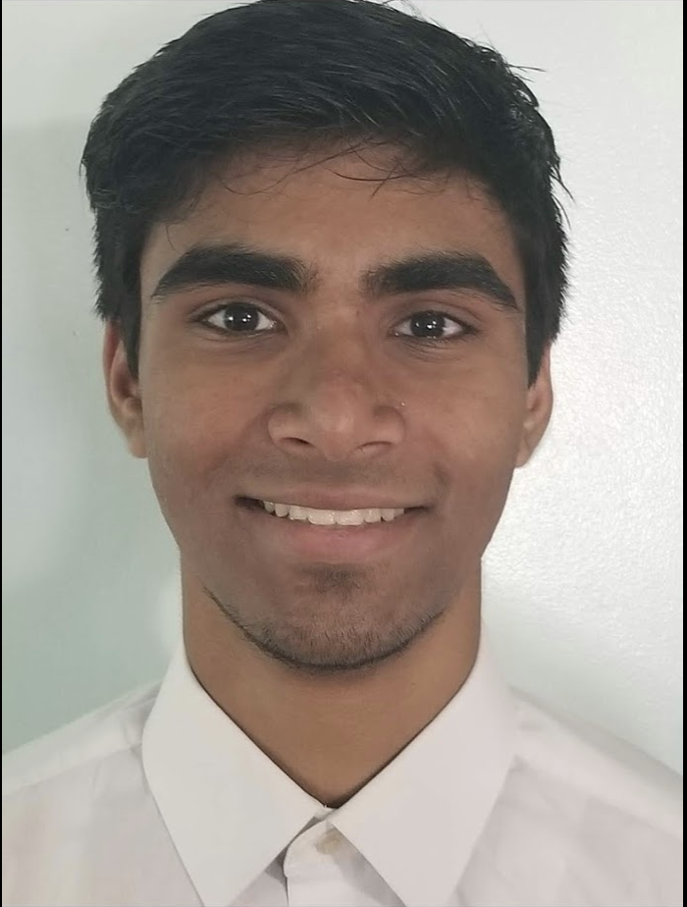


Mysteries of Water
Creative Inquiry
Spring 2020
Parth Patel Tanner Street James Webber

Slide 2
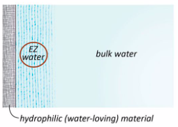
Basis of CI
Gerald Pollack and other scientists noticed particles in water are excluded from an area of water next to some surfaces
It was suspected that this water may have different properties than bulk water and even possibly different structure
This area of water may be responsible for phenomena of water that are not explained by the current principles of water
The goal of our CI was to setup a lab that would be able to explore this area of water by testing properties and conducting experiments

Slide 3
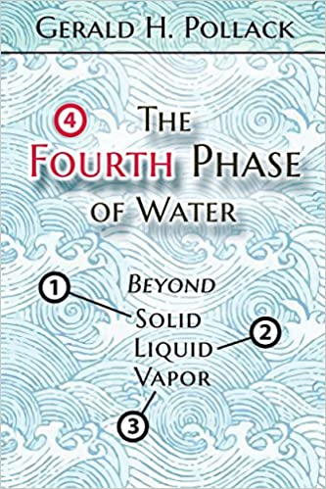
The Fourth Phase of Water
Introduces common phenomena of water that cannot be explained
Describes findings of EZ water
Uses EZ water theory to attempt to explain common behaviors of water as well as the more uncommon
Describes a theoretical structure of water that would be responsible for the characteristics of EZ water
How can warm water freeze faster than cold water?
How does water get to the top of trees?
Why is ice so slippery?

Slide 4
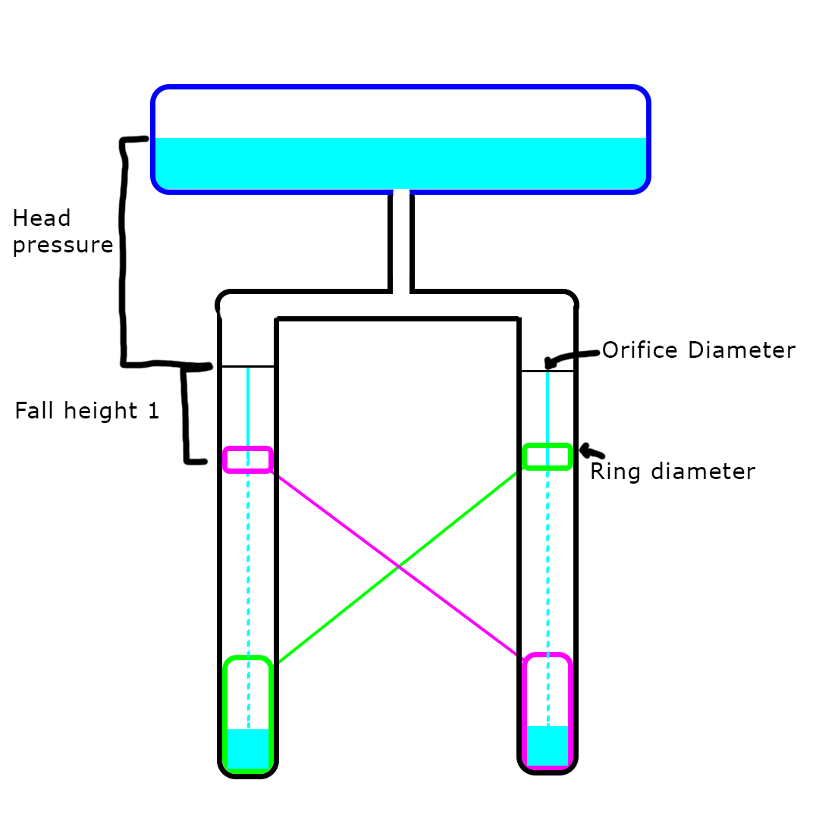
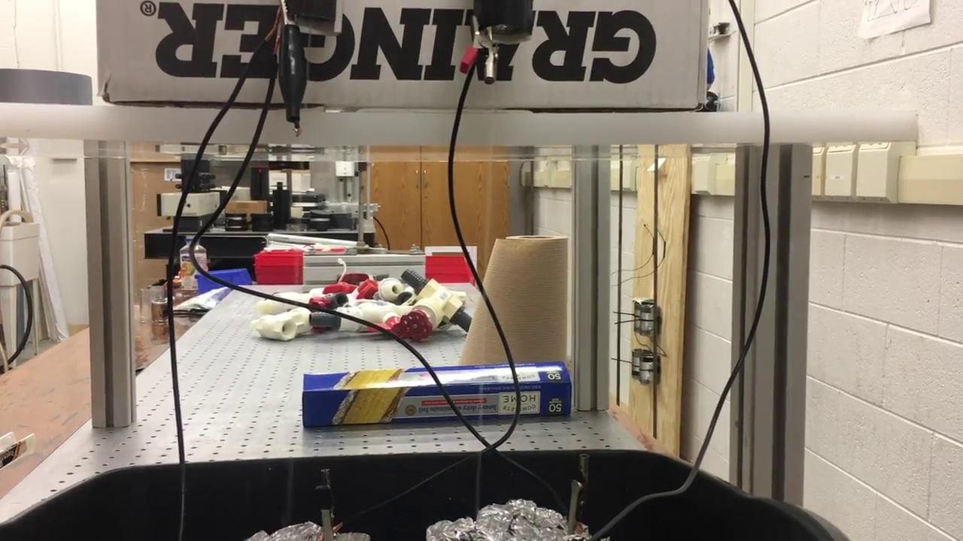
Kelvin water dropper
With no moving parts, a falling stream of water can generate electricity
Many iterations to get a working model
High voltage low current
Bending of water stream
Spark gap
Reservoir shape and size
Droplet formation

Slide 5
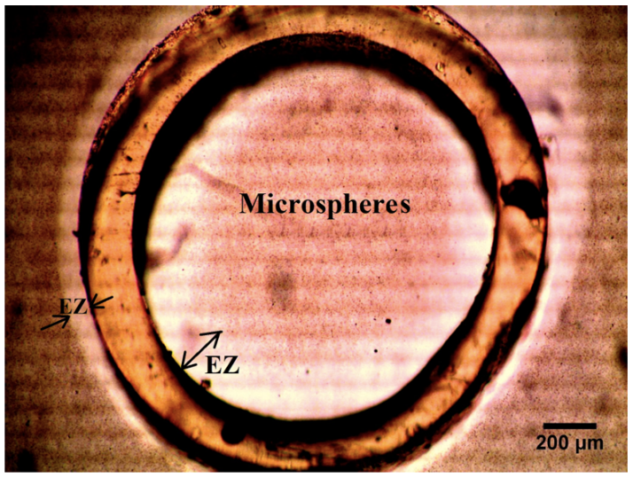
Rohani flow: the principle
Horizontal flow through submerged tubes with no pressure gradient
Principles:
EZ water surrounds nafion/hydrophilic tubes.
EZ layer = negative
Bulk water = positive
Rohani experiment findings:
Self driven flow is observed in nafion and other hydrophilic tubes immersed in water
Hypothesis: an axial proton gradient drives the flow.
This proton generation seems to driven by light. Deduced from: faster flow with UV light
Notes:
Principles = background info that we already know and the foundation of this experiment. Around certain materials such as nafion there is an EZ water layer surrounding the material.

Slide 6
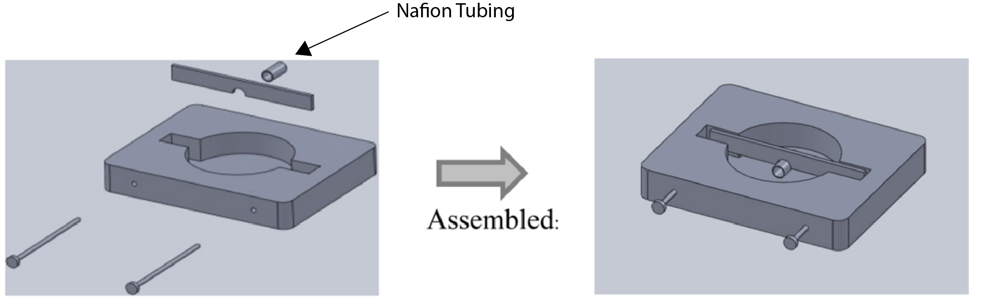
Experiment
Not conducted. Apparatus shown below
Materials: Nafion tubing, distilled deionized water, experimental chamber, microspheres, inverted microscope, UV light source, image data software, camera attachment to microscope.
Notes:
Describe the experiment. How were the materials going to be used?
Wasn’t conducted due to school shutdown

Slide 7

Research database
Goal: To learn more about the theory of EZ water by exploring scientific literature
Mainly focused on the EZ’s characteristics but also critiques
Created a database summarizing a variety of significant papers
Created an effective organizational system

Slide 8

Research database
Skills: Organization and ability to read and understand complex papers
Potential for improvement

Slide 9
Conclusion
Water has so many unexplained behaviors. Being such an abundant molecule, some would assume we know everything about it, but we do not. The largest take away from this research is that water as a group of molecules can behave differently than an individual molecule.

